Slide 1
Ethics Part 3: Ethics in the Business World
Professional Practice 3
N. Wessels
Source: Ethics in Information Technology, 2019. 6th ed. Reynolds, G.W. Cengage Learning, Inc.

Slide 2
Ethics in the Business World
Ethics has risen to the top of the business agenda because the risks associated with inappropriate behaviour have increased.
Abroad, we have seen the collapse of and/or bailout of financial institutions such as Bank of America, Lehman Brothers and American International Group (AIG) due to unwise and/or unethical decision making regarding the approval of mortgages, loans, and lines of credit to unqualified individuals and organisations.
We have also seen many corporate officers and senior managers sentenced to prison terms for their unethical behaviour – e.g. Stewart Parnell, former CEO of Peanut Corporation of America, who was sentenced to 28 years in prison for knowingly shipping contaminated food product, resulting in a salmonella outbreak that killed 9 people and sickened more than 700.
Unethical behaviour can lead to negative consequences for both organisations and individuals.

Slide 3
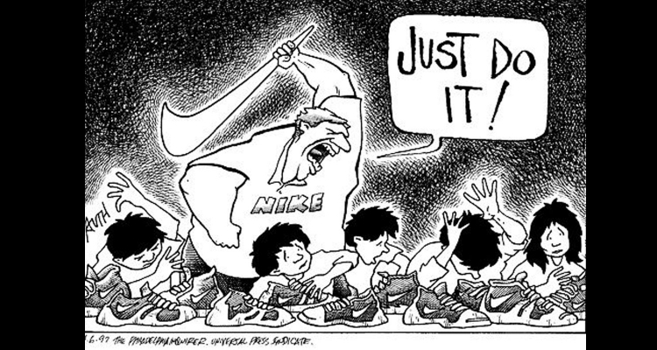
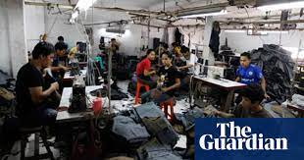
Ethics in the Business World
Several trends have increased the likelihood of unethical behaviour.
First, for many organisations, greater globalisation has created a much more complex work environment that spans diverse cultures and societies, making it more difficult to apply principles and codes of ethics consistently.
For example, numerous U.S. and European companies have moved operations to developing countries, where employees and contractors work in conditions that would not be acceptable in the most developed countries.
https://www.theguardian.com/global-development/poverty-matters/2011/apr/28/sweatshops-supplying-high-street-brands

Slide 4

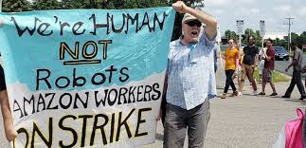
Ethics in the Business World
Second, in today’s challenging and uncertain economic climate, many organisations are finding it more difficult to maintain revenue and profits. Some organisations are tempted to resort to unethical behaviour to maintain profits.
For example, Tesco, Britain’s largest supermarket chain, admitted its first half-year of profits for 2013 were overstated by $400 million. Fiat Chrysler Automobiles admitted its U.S. auto sales were overstated by hundreds of cars each month starting as far back as 2011.

Slide 5
Ethics in the Business World
Employees, shareholders, and regulatory agencies are increasingly sensitive to violations of accounting standards, failures to disclose substantial changes in business conditions, nonconformance with required health and safety practices, and production of unsafe or substandard products.
Such heightened vigilance raises the risk of financial loss for businesses that do not foster ethical practices or that run afoul of required standards.
There is also a risk of criminal and civil lawsuits resulting in fines and/or incarceration for individuals.

Slide 6
Ethics in the Business World – A classic example of the many risks associated with unethical decision making can be found in the Enron accounting scandal
In 2000, Enron - a Texas-based energy company - employed over 22000 people, and it reported an annual revenue of $101 billion. However, in 2001, it was revealed that much of Enron’s revenue was the result of deals with limited partnerships, which it controlled.
In addition, as a result of actions taken contrary to generally accepted accounting practices (GAAP), many of Enron’s debts and losses were not reported in its financial statements. As the accounting scandal unfolded, Enron’s shares dropped from $90 per share to less than $1 per share, and the company was forced to file for bankruptcy.
The Enron case was notorious, but many other corporate scandals have occurred in spite of safeguards enacted as a result of the Enron debacle.

Slide 7

South African example of unethical practices due to accounting irregularities
Steinhoff debacle –Before its collapse, Steinhoff was among the top-10 companies on the Johannesburg Stock Exchange. It is considered the biggest fraud in SA corporate history:
Steinhoff was a stock market darling and its bosses were regarded as South Africa’s experts in globalization.
https://www.biznews.com/sa-investing/2018/07/06/steinhoff-scandal-unpacked-must-read-five-part-series
South African retailer Steinhoff said an independent report had found it had overstated profits over several years in a $7.4 billion accounting fraud involving a small group of top executives and outsiders. The scandal has all but wiped out shareholders’ equity and led to several resignations including chief executive Markus Jooste, who was instrumental in putting Steinhoff on investor radar screens. The scandal has wiped out 216 billion rand from Steinhoff’s market value since December 2017, a dramatic turnaround of fortunes for a company that was once a must-have in fund managers’ portfolios. Steinhoff said investigators found that top management figures entered into fictitious transactions with entities purported to be independent third parties, to create the illusion of income used to hide losses at the company’s operating units.
https://www.reuters.com/article/us-steinhoff-intln-accounts-idUSKCN1QW2C2

Slide 8
Journalist’s comments on Steinhoff
Tom Eaton (The Times 11/12/17) comments aptly on the manner in which the corporate elite has responded to the Steinhoff debacle. Losses amounting to more than R100-billion, exceeding, in 48 hours, the amounts the Guptas are accused of looting over a decade. Apart from qualifying as the biggest fraud in South African corporate history, the scandal sheds unflattering light not only on the morals of the corporate elite, but also their reputed financial wizardry to which their enormous wealth is so regularly attributed.
Pointing to the use of the euphemism “accounting irregularity” to describe the actions of the Steinhoff Mafia sitting atop this multinational empire, Eaton opines “… many South Africans are demanding that stronger language be used, pointing out that the middle class and the media, always so quick to unload both barrels at state corruption, tend to go easy on dirty corporates.
Condemning the tendency to create a false juxtaposition between state and private sector fraud – treating the latter as a kind of victimless crime – Eaton reminds his readers that the worst damage has been suffered not by Steinhoff’s biggest shareholder Christo Wiese. He has suffered the “indignity” of being relegated from the premier league of dollar millionaires to the ABC Motsepe League of mere millionaires. Nor, similarly, the fall guy – former CEO Markus Jooste – who can now look forward to spending more time at various race courses with his horses around the world after resigning following making some “big mistakes”.
The biggest victims are government employees – the 1.2-million who contribute towards the Government Employees Pension Fund keeping 400,000 pensions afloat – who had no say in the Steinhoff investment, and who are now poorer by R12-billion. Should Steinhoff go bankrupt, which is not ruled out, 130,000 jobs across the world are threatened.
Source: https://www.dailymaverick.co.za/opinionista/2017-12-13-the-steinhoff-debacle-the-biggest-fraud-in-sa-history/
Around R5.50/Steinhoff share expected in shareholders settlement (7/03/2022):
https://www.moneyweb.co.za/news/companies-and-deals/around-r5-50-steinhoff-share-expected-in-shareholders-settlement/

Slide 9
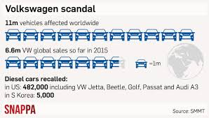
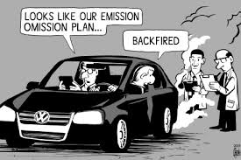


Ethics in the Business World – a few examples of lapses in business ethics by employees in IT organisations:
Volkswagen has admitted that 11 million of its vehicles were equipped with software that was used to cheat on emissions tests.

Slide 10
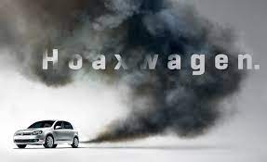
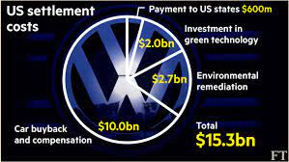
.
Volkswagen installed emissions software on more than a half-million diesel cars in the U.S.—and roughly 10.5 million more worldwide—that allows them to sense the unique parameters of an emissions drive cycle set by the Environmental Protection Agency. According to the EPA and the California Air Resources Board, which were tipped off by researchers in 2014, these so-called “defeat devices” detect steering, throttle, and other inputs used in the test to switch between two distinct operating modes.
In the test mode, the cars are fully compliant with all federal emissions levels. But when driving normally, the computer switches to a separate mode—significantly changing the fuel pressure, injection timing, exhaust-gas recirculation, and, in models with AdBlue, the amount of urea fluid sprayed into the exhaust. While this mode likely delivers higher mileage and power, it also permits heavier nitrogen-oxide emissions (NOx)—a smog-forming pollutant linked to lung cancer—up to 40 times higher than the federal limit. That doesn’t mean every TDI is pumping 40 times as much NOx as it should. Some cars may emit just a few times over the limit, depending on driving style and load.
https://www.caranddriver.com/news/a15339250/everything-you-need-to-know-about-the-vw-diesel-emissions-scandal/

Slide 11
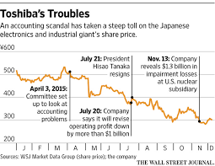
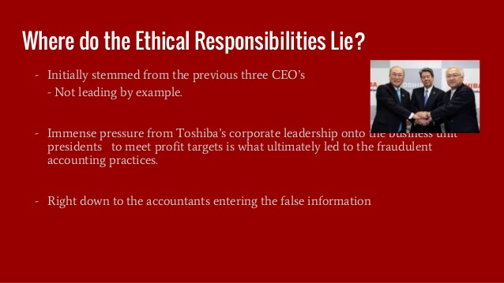
Ethics in the Business World – a few examples of lapses in business ethics by employees in IT organisations:
Toshiba, the Japanese industrial giant whose diversified products and services include information technology and communications equipment and systems, disclosed that it overstated its earnings over a 7 year period by more than $1.2 billion.

Slide 12

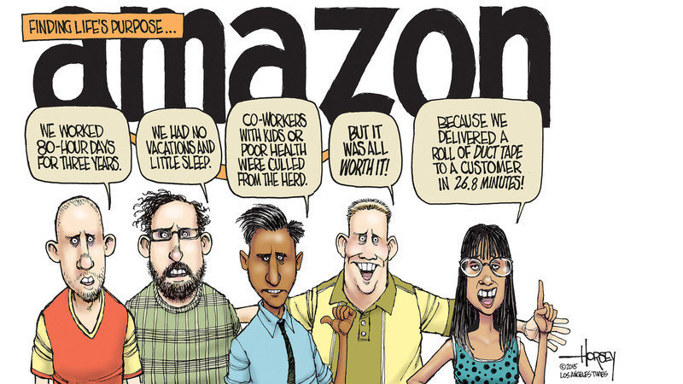
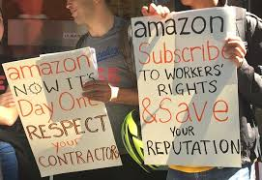
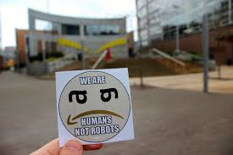

Ethics in the Business World – a few examples of lapses in business ethics by employees in IT organisations:
Amazon has the 2nd highest employee turnover rate of companies in the Fortune 500 and has been criticized for creating a high pressure environment in which bosses’ expectations were almost impossible to satisfy and jobs were threatened if illness or other personal issues encroached on work.

Slide 13
Extract from Forbes investigative report
In the investigative piece….the New York Times alleged, “For at least a year and a half—including during periods of record profit—Amazon had been shortchanging new parents, patients dealing with medical crises and other vulnerable workers on leave, according to a confidential report on the findings.”
The investigative findings indicated that workers at facilities across the country had to contend with questionable payroll software that led to people with “medical problems and other life crises having been fired when the attendance software mistakenly marked them as no-shows.” It was reported, “Doctors’ notes vanished into black holes in Amazon’s databases. Employees struggled to even reach their case managers, wading through automated phone trees [that gave them the runaround].”
A prior New York Times investigative piece reported on the difficult working conditions Amazon employees had to endure at a fulfillment warehouse in Staten Island, New York, during the Covid-19 pandemic. The piece contended that Bezos “discovered what he thought was another inefficiency worth eliminating: hourly employees who spent years working for the same company.” Sources claim that Bezos held a theory that workers expect raises, but at the same time, they become complacent over time, and don’t work as hard. Consequently, wages increase, while productivity declines.
The solution was to replace workers before their productivity further deteriorated and pay increased. It's more efficient to hire fresh, new people. Amazon then basically encouraged workers to leave. The constant churning of workers helped keep efficiency high and wages fairly low. The prevailing wisdom was, “After three years on the job, hourly workers no longer received automatic raises, and the company offered bonuses to people who quit. It also offered limited upward mobility for hourly workers, preferring to hire managers from the outside.”
https://www.forbes.com/sites/jackkelly/2021/10/25/a-hard-hitting-investigative-report-into-amazon-shows-that-workers-needs-were-neglected-in-favor-of-getting-goods-delivered-quickly/?sh=fb4395b51f50

Slide 14
Extract from Forbes investigative report
There have been many complaints from employees at Amazon’s fulfillment centers. Workers alleged that they are given back-breaking tasks in the warehouses. They also vent their dismay over intrusive surveillance technologies, including automated tracking systems and cameras that monitor their every move. There is a palpable fear that if workers don’t meet specified quotas, they’ll be fired. This has led to workers calling for a union. A union drive in Alabama was attempted, but was thwarted and didn’t succeed.
In an effort to help the mental health and well-being of warehouse and fulfillment centers, the retailer launched “WorkingWell,” a comprehensive program providing employees with wellness exercises. The program was part of an initiative by the giant online-shopping empire to invest over $300 million into safety projects in 2021 for its workers.
Part of the wellness program includes AmaZen. It “guides employees through mindfulness practices” inside of interactive kiosks stationed at the worksites. Employees are encouraged to “visit AmaZen stations and watch short videos featuring easy-to-follow well-being activities, including guided meditations, positive affirmations, calming scenes with sounds and more.”
The rollout didn’t get the glowing reviews the company had hoped for. The online vitriol was brutal. It felt that the program brought out all of the pent-up anger simmering against the online behemoth.
This includes its treatment of employees and resentment of outgoing CEO, Bezos, who profited handsomely during the pandemic, reaping billions more to his already-staggering net worth, while millions of workers across the country suffered layoffs and a rapid decline in their financial and living standards.
Vice savagely reported, “In one of its most dystopian moves yet, Amazon is introducing tiny booths where its overworked warehouse employees can momentarily escape a job so grueling, many employees say they don't feel like they have enough time to even use the bathroom.” The piece pointed out, “What this looks like in reality is a coffin-sized booth in the middle of an Amazon warehouse where workers can use a computer to view ‘mental health and mindful practices.’"
https://www.forbes.com/sites/jackkelly/2021/10/25/a-hard-hitting-investigative-report-into-amazon-shows-that-workers-needs-were-neglected-in-favor-of-getting-goods-delivered-quickly/?sh=fb4395b51f50

Slide 15
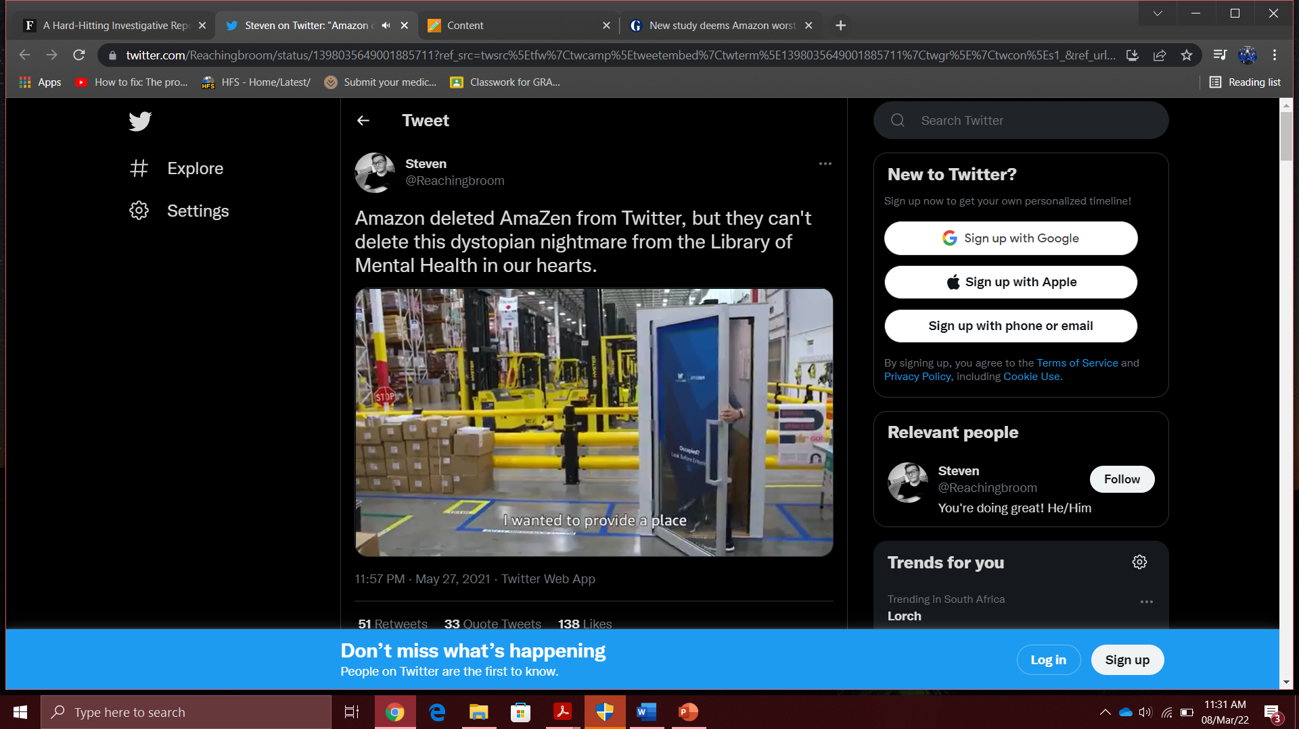
.

Slide 16
Study deems Amazon worst for 'aggressive' tax avoidance (2019) .
The big six US tech firms have been accused of “aggressively avoiding” $100bn (£75bn) of global tax over the past decade.
Amazon, Facebook, Google, Netflix, Apple and Microsoft have been named in a report by tax transparency campaign group Fair Tax Mark as avoiding tax by shifting revenue and profits through tax havens or low-tax countries, and for also delaying the payment of taxes they do incur.
The report singles out Amazon, which is run by the world’s richest person, Jeff Bezos, as the worst offender. It said the group paid just $3.4bn (£2.6bn) in tax on its income so far this decade despite achieving revenues of $960.5bn and profits of $26.8bn. Fair Tax Mark said this means Amazon’s effective tax rate was 12.7% over the decade when the headline tax rate in the US has been 35% for most of that period.
https://www.theguardian.com/business/2019/dec/02/new-study-deems-amazon-worst-for-aggressive-tax-avoidance
https://www.theguardian.com/technology/2021/may/04/amazon-sales-income-europe-corporation-tax-luxembourg

Slide 17
Ethics in the Business World – a few examples of lapses in business ethics by employees in IT organisations:
As the previous examples illustrate, it is not unusual for powerful, highly successful individuals to fail to act morally.
Such people are often aggressive in striving for what they want and are used to having privileged access to information, people, and other resources.
Furthermore, their success often inflates their belief that they have the ability and the right to manipulate the outcome of any situation.
According to the 2013 National Business Ethics Survey (USA), it is managers – those expected to act as role models and enforce discipline – who are responsible for 60% of workplace misconduct.
The moral corruption of people in power, which is often facilitated by a tendency for people to look the other way when their leaders act inappropriately is called the Bathsheba syndrome – a reference to the biblical story of King David, who became corrupted by his power and success.

Slide 18
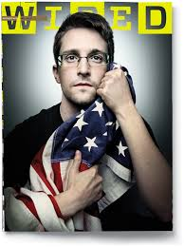

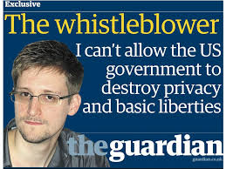
Ethics in the Business World – examples of ethical dilemmas even ordinary individuals can find themselves in:
Edward Snowden, working as a Dell contractor at the National Security Agency (NSA) in The United States, copied thousands of classified and unclassified documents that revealed details about the capabilities and scope of operations of the NSA and other foreign intelligence agencies.
The documents were then handed over to reporters who published many of the disclosures in The Guardian and Washington Post newspapers.
Snowden felt he acted as a patriot in exposing the behaviour of the NSA, which he believed was overreaching and counter to the U.S. Constitution. Some consider him a traitor, while others view him as a whistle-blower and a hero.
https://www.amnesty.org/en/latest/campaigns/2015/06/7-ways-the-world-has-changed-thanks-to-edward-snowden/

Slide 19
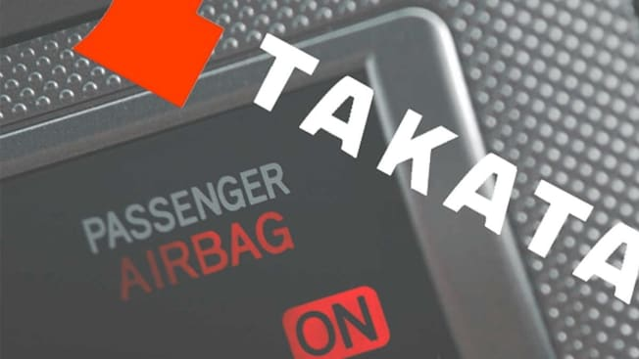

Ethics in the Business World – examples of ethical dilemmas even ordinary individuals can find themselves in:
Mark Lillie, a former Takata Corporation engineer, warned the company of the potential deadly consequences of using the propellant ammonium nitrate to inflate its airbags.
The use of ammonium nitrate enabled Takata to earn a greater profit than other designs, however, it also resulted in devices that can deploy with too much force, causing them to rupture and shoot metal fragments at motorists. Unfortunately, Lillie was unable to convince management at Takata to choose an alternative design.
He eventually left the firm in disagreement over this fatal manufacturing decision. In the United States, to date, there have been 19 deaths and more than 400 injuries because of this problem. Worldwide, NHTSA reports that there have been at least 27 deaths.
https://www.consumerreports.org/car-recalls-defects/takata-airbag-recall-everything-you-need-to-know-a1060713669/

Slide 20
How Organisations Can Improve Their Ethics
A well-implemented ethics and compliance programme and a strong ethical culture can lead to less pressure on employees to misbehave and a decrease in observed misconduct.
It also creates an environment in which employees are more comfortable reporting instances of misconduct, partly because there is less fear of potential retaliation by management against reporters.

Slide 21
How Organisations Can Improve Their Ethics
The Ethics Resource Centre has defined the following characteristics of a successful ethics programme:
Characteristics of a successful ethics programme:
Employees are willing to seek advice about ethics-related issues.
Employees feel prepared to handle situations that could lead to misconduct.
Employees are rewarded for ethical behaviour.
The organization does not reward success obtained through questionable means.
Employees feel positively about their company.

Slide 22
How Organisations Can Improve Their Ethics
Appoint a Corporate Ethics Officer
A corporate ethics officer (also called a corporate compliance officer) provides an organisation with vision and leadership in the area of business conduct.
This individual aligns the practices of a workplace with the stated ethics and beliefs of that workplace, holding people accountable to ethical standards.

Slide 23
How Organisations Can Improve Their Ethics
2. Require the Board of Directors to Set and Model High Ethical Standards:
The board of directors is responsible for the careful and responsible management of an organization.
For-profit organisation – board’s primary objective is to oversee the organisation’s business activities and management for the benefit of all stakeholders, including shareholders, employees, customers, suppliers, and the community.
Non-profit organisation – board reports to a different set of stakeholders - in particular, the local community that the non-profit serves.

Slide 24
How Organisations Can Improve Their Ethics
A board of directors fulfils some of its responsibilities directly and assigns others to various committees.
The board is not normally responsible for day-to-day management and operations; these responsibilities are delegated to the organisation’s management team.
However, the board is responsible for supervising the management team.
Therefore board members are expected to conduct themselves according to the highest standards for personal and professional integrity while setting the standard for company-wide ethical conduct and ensuring compliance with laws and regulations.
Board members must set an example and set a tone for high-level ethical behaviour.
Importantly , board members must create an environment in which employees feel they can seek advice about appropriate business conduct, raise issues, and report misconduct through appropriate channels.

Slide 25
How Organisations Can Improve Their Ethics
3. Establish a Corporate Code of Ethics:
A code of ethics is a statement that highlights an organisation’s key ethical issues and identifies the overarching values and principals that are important to the organisation and its decision making.
Codes of ethics frequently include a set of formal, written statements about the purpose of an organisation, its values, and the principals that should guide its employees’ actions.
It should focus employees on areas of ethical risk relating to their role in the organisation, offer guidance to help them recognise and deal with ethical issues, and provide mechanisms for reporting unethical conduct and fostering a culture of honesty and accountability.
A code of ethics must be easily accessible by employees, shareholders, business partners and the public.
It must be continually applied to a company’s decision making and emphasized as an important part of its culture.

Slide 26
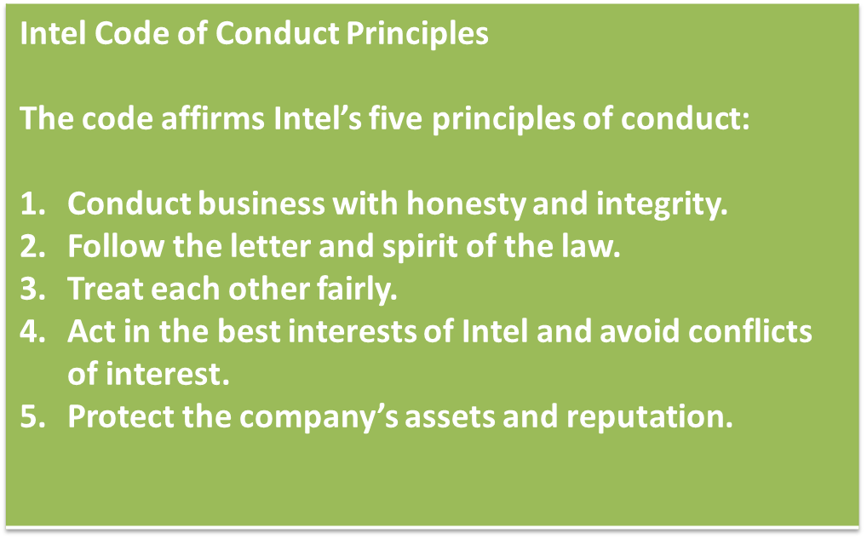
How Organisations Can Improve Their Ethics
A summary of Intel’s code of ethics:
Each year, Corporate Responsibility magazine rates publicly held U.S. companies on their corporate ethical performance.
Intel Corporation, the world’s largest chip maker, has been ranked in the top 25 every year since the list began in 2000, and was ranked 2nd in 2016.
As such, Intel is recognised as one of the most ethical companies in the IT industry.

Slide 27
How Organisations Can Improve Their Ethics
4. Conduct Social Audits
An increasing number of organisations conduct regular social audits of their policies and practices.
In a social audit, an organisation reviews how well it is meeting its ethical and social responsibility goals and communicates its new goals for the upcoming year.
This information is shared with employees, shareholders, investors, market analysts, customers, suppliers, government agencies, and the communities within which the company operates.

Slide 28
How Organisations Can Improve Their Ethics
5. Require Employees to Take Ethics Training:
Psychologists and philosophers agree that while many factors stimulate a person’s moral development, one of the most crucial is education.
Other researchers support the idea that people can continue their moral development through further education, like working through case studies and examining contemporary issues.
Thus, a company’s code of ethics must be promoted and continually communicated within the organisation, from the top to the bottom.
Organisations can do this by showing the employees examples of how to apply the code of ethics in real life, by for example, providing a comprehensive ethics programme through small workshops.
Here, employees apply the organisation’s code of ethics to hypothetical but realistic case studies. Employees may also be given examples of recent company decisions based on principles from the code of ethics.

Slide 29
How Organisations Can Improve Their Ethics
6. Include Ethical Criteria in Employee Appraisals:
Increasingly, managers are including ethical conduct as part of an employee’s performance appraisal.
Those that do so base a portion of their employees’ performance evaluations on:
Treating others fairly and with respect.
Operating effectively in a multicultural environment.
Accepting personal accountability for meeting business needs.
Continually developing others and themselves.
Operating openly and honestly with suppliers, customers, and other employees.

Slide 30
How Organisations Can Improve Their Ethics
7. Create an ethical work environment:
Most people want to perform their jobs successfully and ethically, but sometimes good people make bad ethical choices.
Employees in highly competitive workplaces often feel pressure from aggressive competitors, cutthroat suppliers, unrealistic budgets, tight deadlines, and bonus incentives.
Employees may also be encouraged to ‘do whatever it takes’ to get the job done.
In such environments, some employees may feel pressure to engage in unethical conduct to meet management’s expectations, especially if the organisation has no corporate code of ethics and no strong example of senior management practicing ethical behaviour.

Slide 31
How Organisations Can Improve Their Ethics
Manager’s checklist for establishing an ethical work environment:
Does your organisation have a code of ethics? Do employees know how and to whom to report any infractions of the code of ethics? Do employees feel that they can report violations of the code of ethics safely and without fear of retaliation? Do employees feel that action will be taken against those who violate the code of ethics? Do senior managers set an example by communicating the code of ethics and using it in their own decision making? Do managers evaluate and provide feedback to employees on how they operate with respect to the values and principles in the code of ethics? Are employees aware of sanctions for breaching the code of ethics? Do employees use the code of ethics in their decision making?

